Slide 1
Full Stack Application Development
Understanding Frontend Development
Client Side Scripting
Interactive Webpages
Akshaya Ganesan

Slide 3
Frontend technologies
What happens when you load your webpage in the browser?
The code (the HTML, CSS, and JavaScript) are running inside an execution environment (the browser).
HTML is the markup language that we use to structure and give meaning to our web content.
CSS is a language of style rules that we use to apply styling to our HTML content, for example, setting background colors and fonts and laying out our content in multiple columns.
JavaScript is a scripting language that enables you to create dynamically updating content and adds interactivity to your webpage.

Slide 4
Javascript
JavaScript is the programming language of the web.
JavaScript is a single-threaded interpreted language.
Every browser has its own JavaScript engine. Google Chrome has the V8 engine, Mozilla Firefox has SpiderMonkey.
The core client-side JavaScript language consists of some common programming features like variables, objects, functions etc.,

Slide 5
Host Environment
Browsers- Initially only implemented in web browsers
Now it can be used on Server Side
Client Side(Browser)
Server Side(NodeJS)
Different browsers provide their own JS engines
Google’ s V8 was extracted to run anywhere- Node.js
Allows interaction with web page(HTML and CSS)
Node is a fast C++-based JavaScript interpreter
Interact with browser API s (History, Location)
Work with file systems, Web servers
Knowledge Reuse

Slide 6
The Critical Rendering Path
The Critical Rendering Path is the sequence of steps the browser goes through to convert the HTML, CSS, and JavaScript into pixels on the screen.
The critical rendering path includes the Document Object Model (DOM), CSS Object Model (CSSOM), render tree and layout.

Slide 7
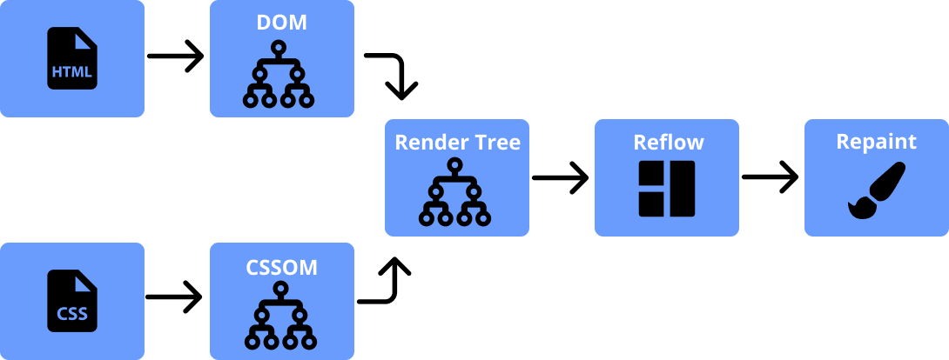
The Critical Rendering Path

Slide 8
The Critical Rendering Path
To render content the browser has to go through a series of steps:
1
2
3
4
5
Document Object Model(DOM)
CSS object model(CSSOM)
Render Tree
Layout
Paint
Characters
Tokens
Nodes
DOM
Characters
Tokens
Nodes
CSSOM

Slide 9
Interactive Webpages

Slide 10
Thank You!

